Slide 1

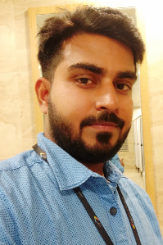
Sarva Priya Ajay
Application Development Analyst
Areas of Expertise
Photo
Sarva Priya Ajay
Application Development Analyst
3.8 years of experience
Programming Skill: Java, EPiServer CMS, DevOps
Platforms: Linux, Windows,
Tools: Docker, Jenkins,AWS
Accenture Services Pvt. Ltd.
Hyderabad
Selected Experience
Global Pharmaceutical –
Roles and Responsibilities -
Enhancing application by implementing new business requirements.
As a part of application maintenance resolving incidents and service request for more than 250 digital marketing websites hosted on EpiServer Platform.
Supported business on critical platform activities like site launch and DNS changes.
Performed compliance activities for more than 15 applications by coordinating with client compliance team.
Deployed application using weblogic java platform from staging to production after fixing bugs.
Professional Background
Overall 3.8 years of experience in Java and EPiServer CMS.
Provided Application support for Digital Marketing websites hosted on EPiServer.
Enhanced Java applications hosted on Verizon cloud.
Ready to get cross trained on new technologies.
Trained in Devops
Academic Background :
B.Tech. in Information Science and Technology from acharya Institute of technology, Bangalore
Notes:
1

